Slide 1
Next Women Application
“Futuristic view of Next generation women”
By:
Yogita Tipnis

Slide 2
Idea
Next Women Application is a simple , open source platform for Women Empowerment.
It aims create next generation women who are aware of their rights, are self-sufficient to protect themselves and aims to be financially independent.
It provides all the necessary tools and information for self development.
It also provides language compatibility, which makes it easier to use and learn from, specially for women's in rural region.
It targets women across all the regions who are curious and enthusiastic to become next generation women.

Slide 3
Key Features
Know Your Rights
Create awareness about women empowerment schemes provided by the government of India.
Self Defence
Information about the self defence techniques every women should know.
Self Learning
Provides list of important website to start the self learning journey.
Job Opportunities
Quick guide to woman-centric Job portals.
Success Stories
Motivates women with inspirational stories and platform to add your story

Slide 4
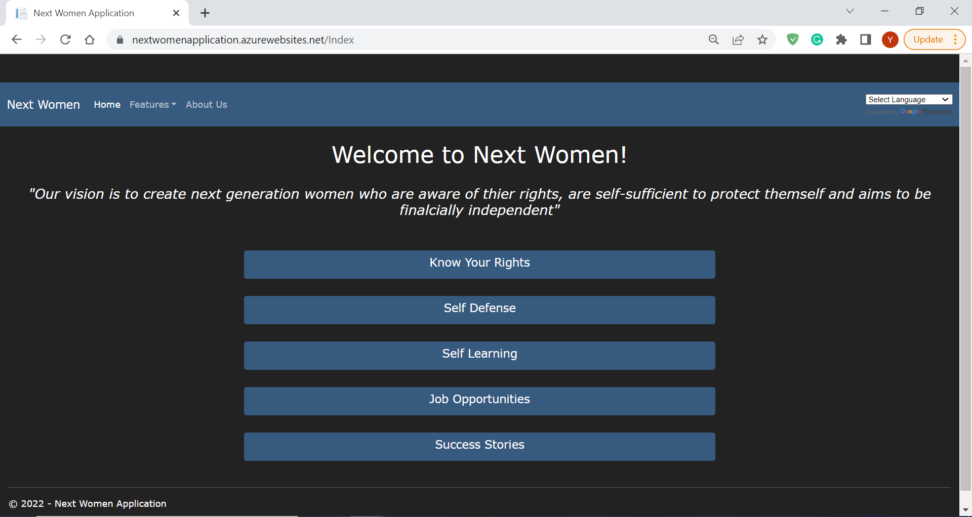
Home Page

Slide 5
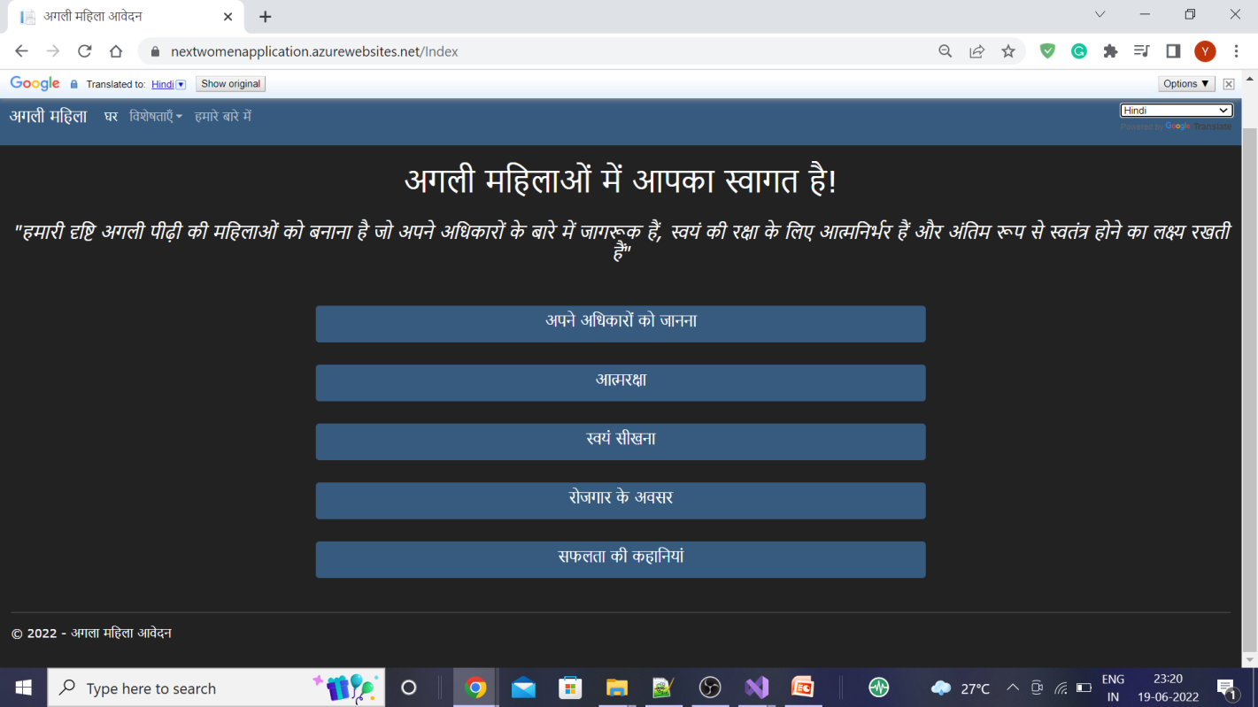
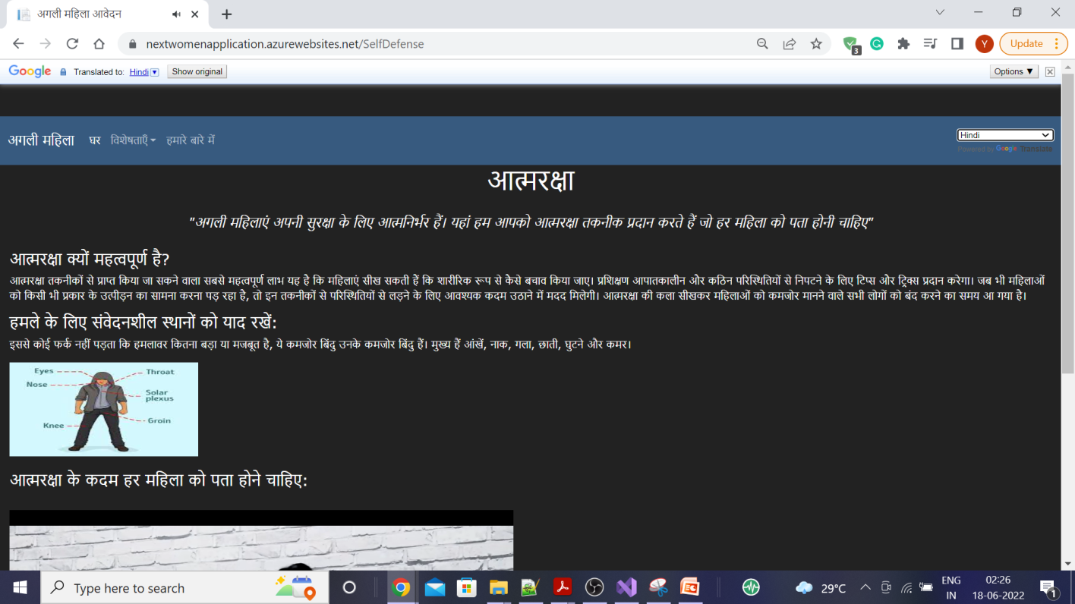
Supports 133 different languages which makes it easier for women's in rural region to use the application

Slide 6
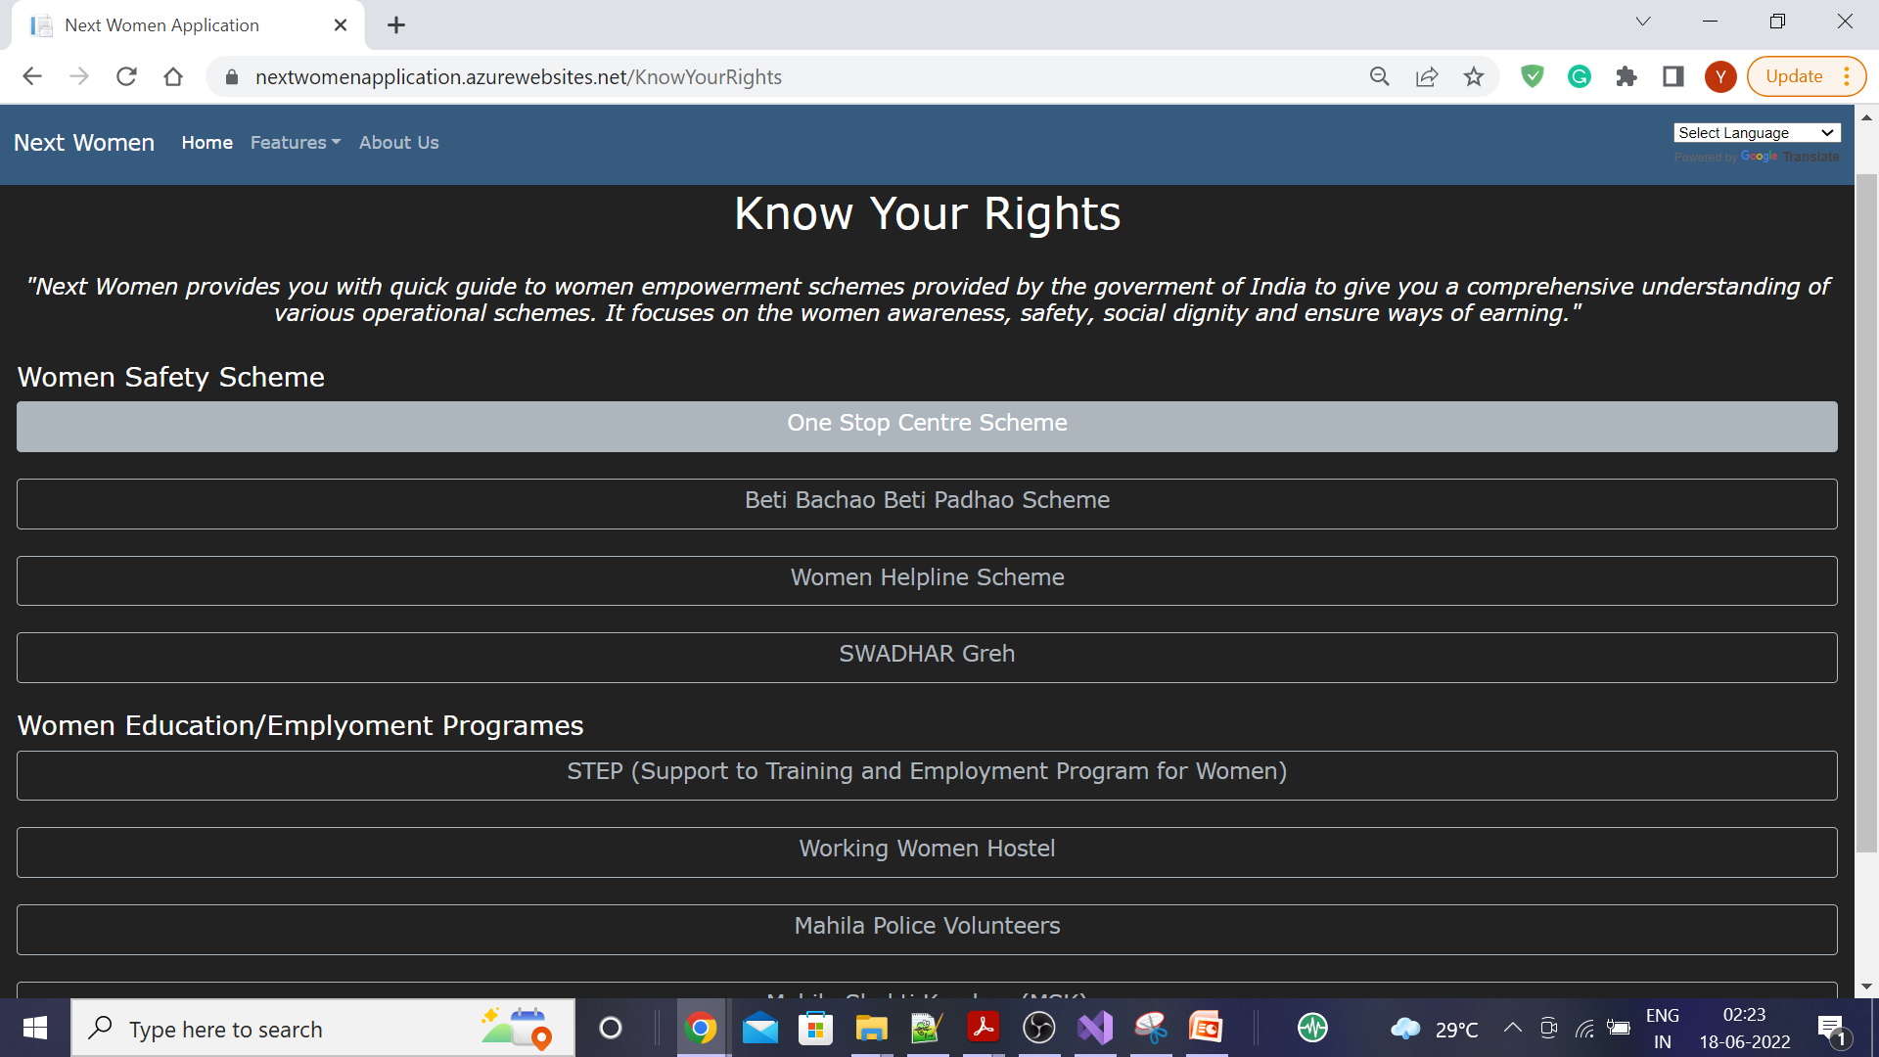
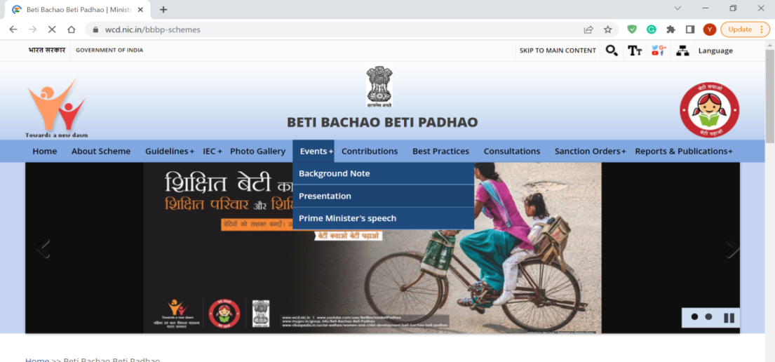
Know Your Rights : This feature aim to create awareness about women empowerment schemes provided by the government of India

Slide 7
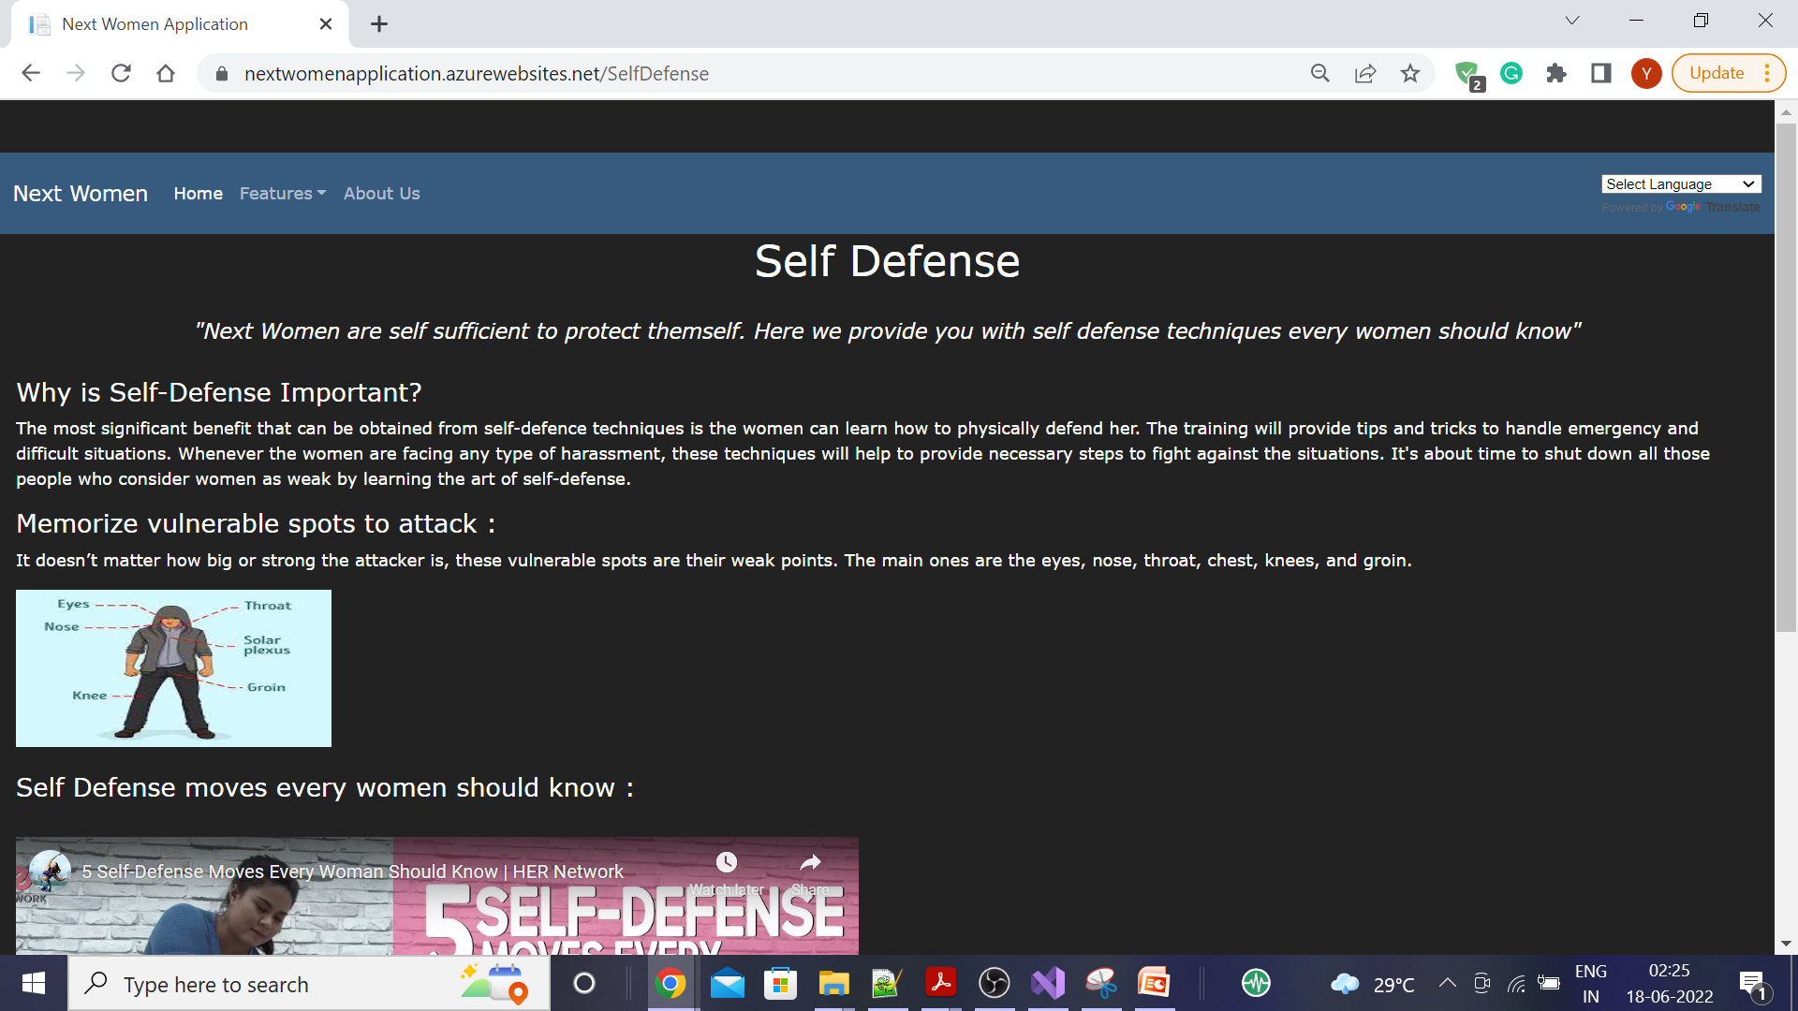
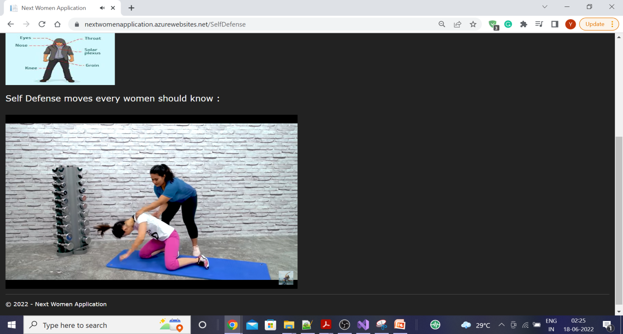
Self Defence This feature provides Information about the self defence techniques every women should know. The motive here is to make self sufficient to protect themselves.

Slide 8
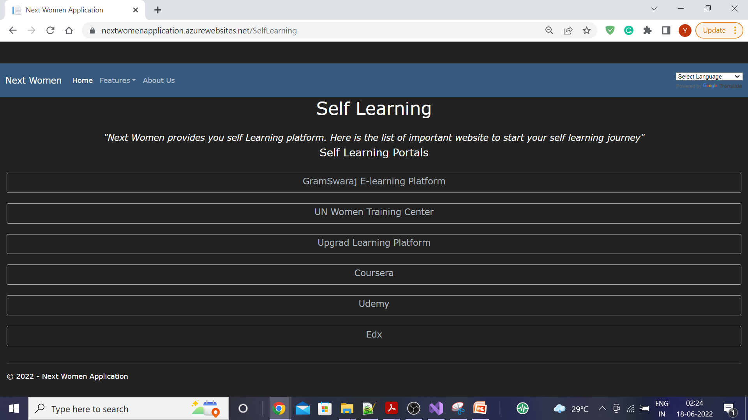
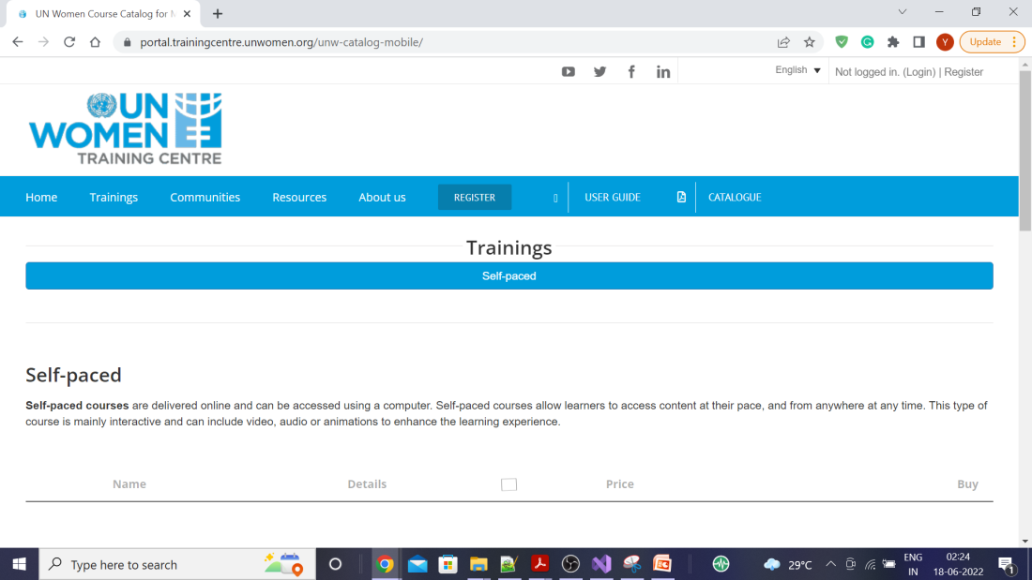
Self Learning : Provides list of important website to start your self learning journey

Slide 9
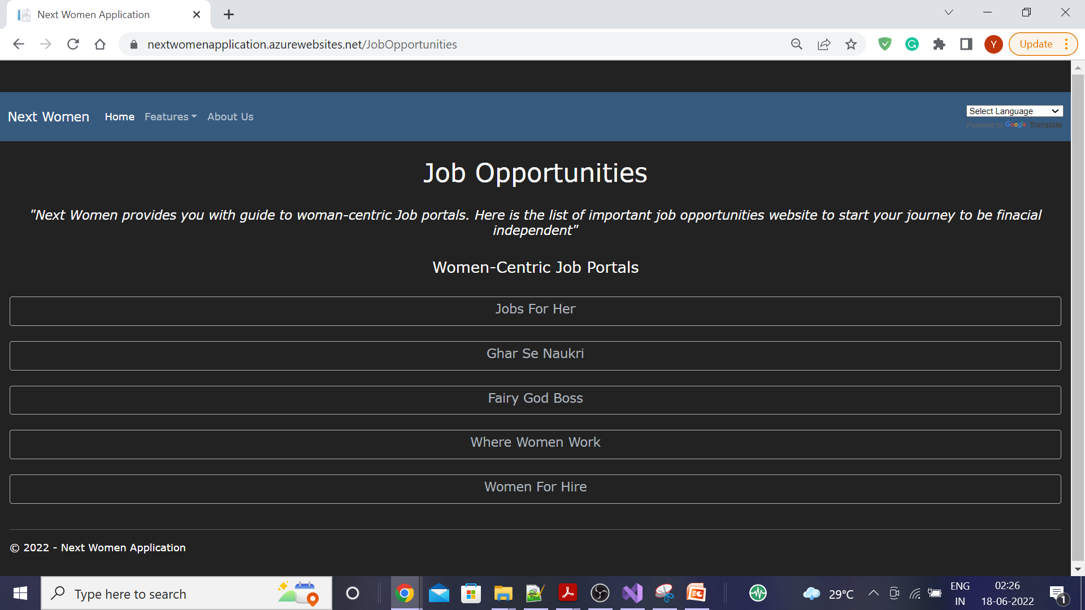
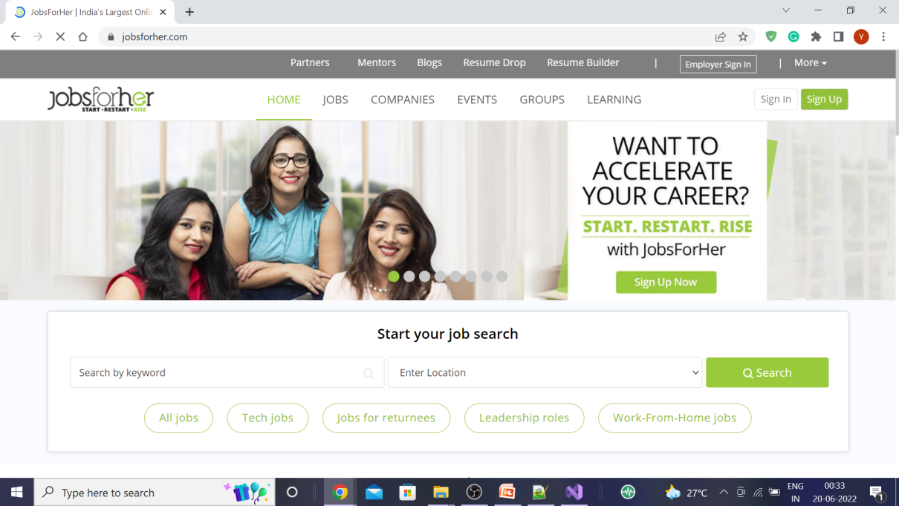
Job Opportunities Provides with a quick guide to woman-centric Job portals

Slide 10
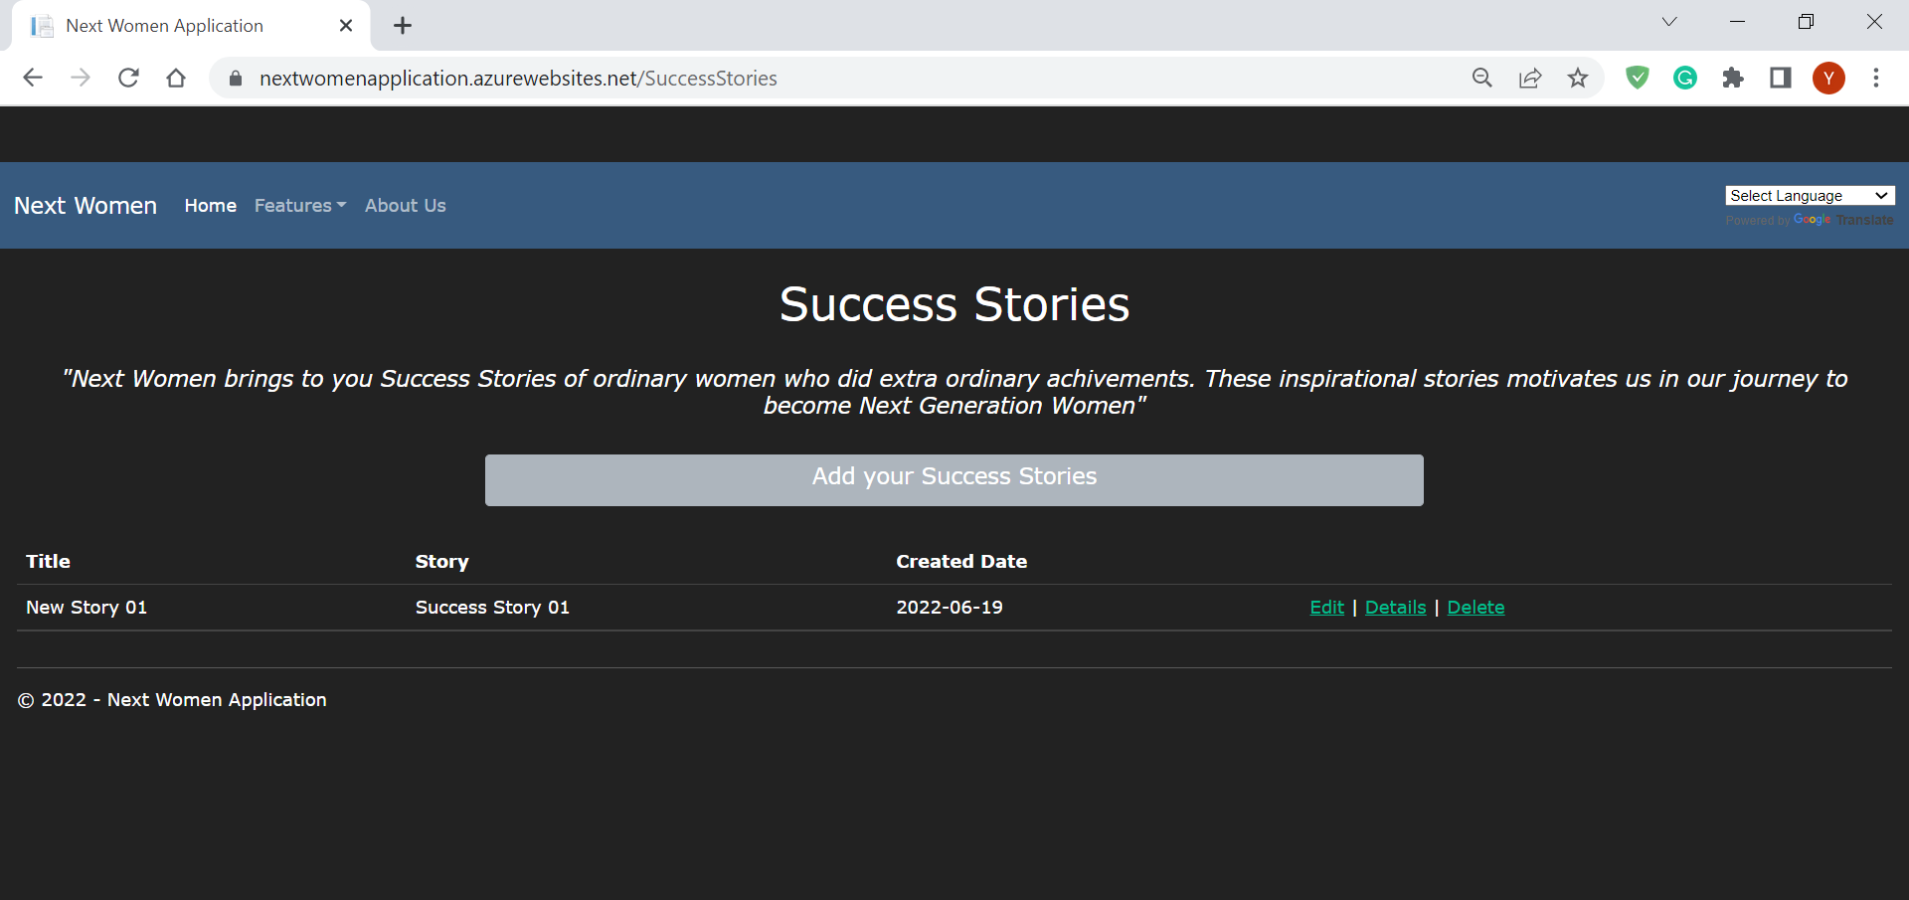
Success Stories: This features provides Success Stories of ordinary women who did extra ordinary achievements. These inspirational stories motivates us in our journey to become Next Generation Women

Slide 11
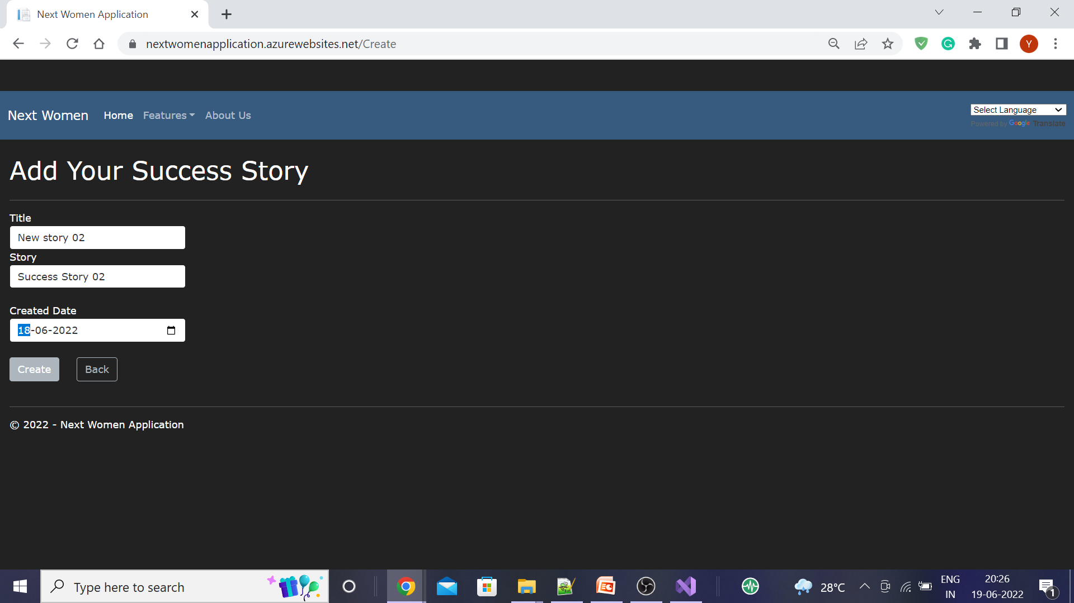
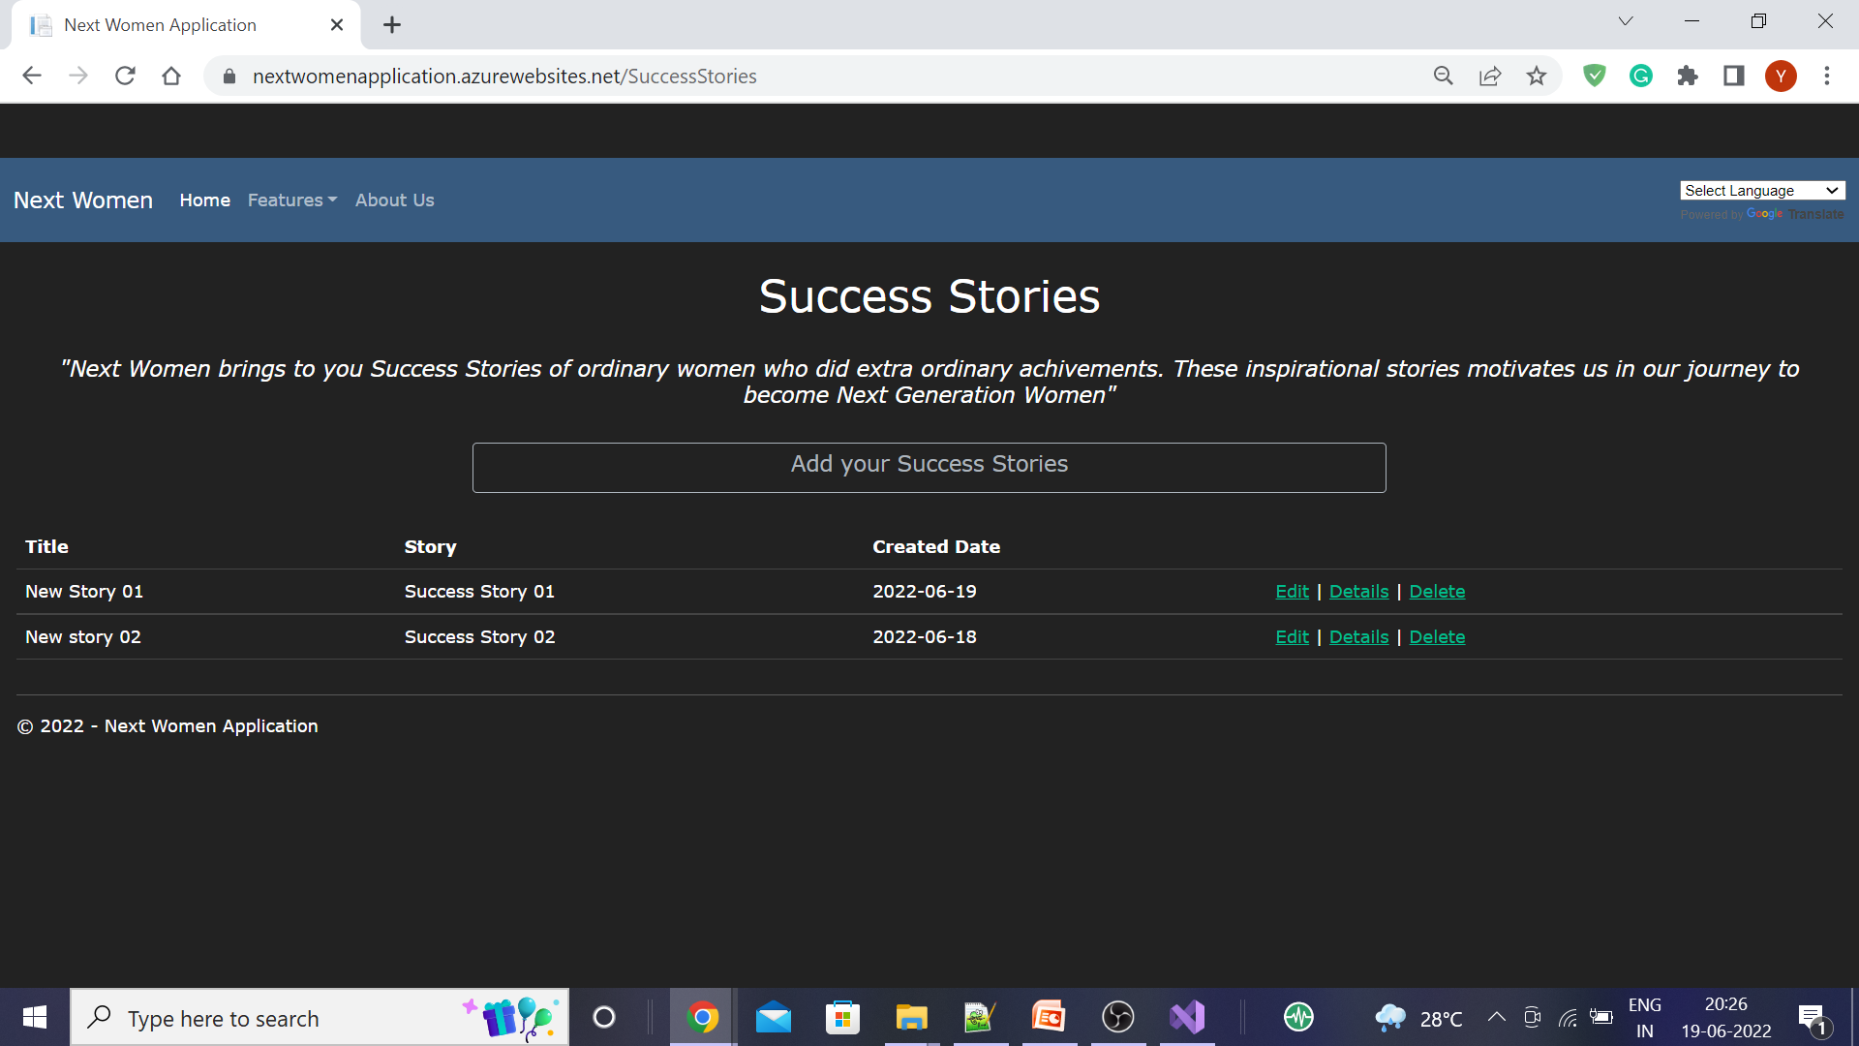
Add your success story

Slide 12
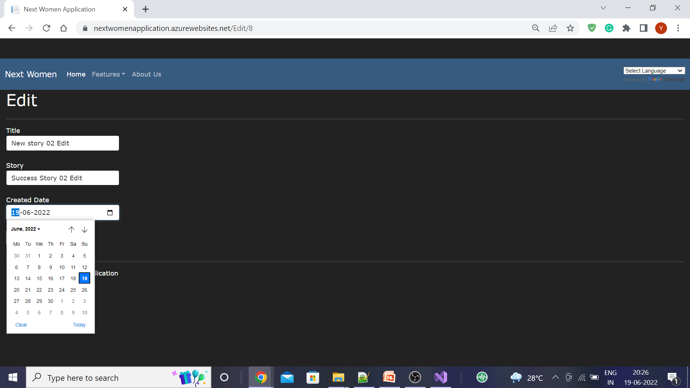
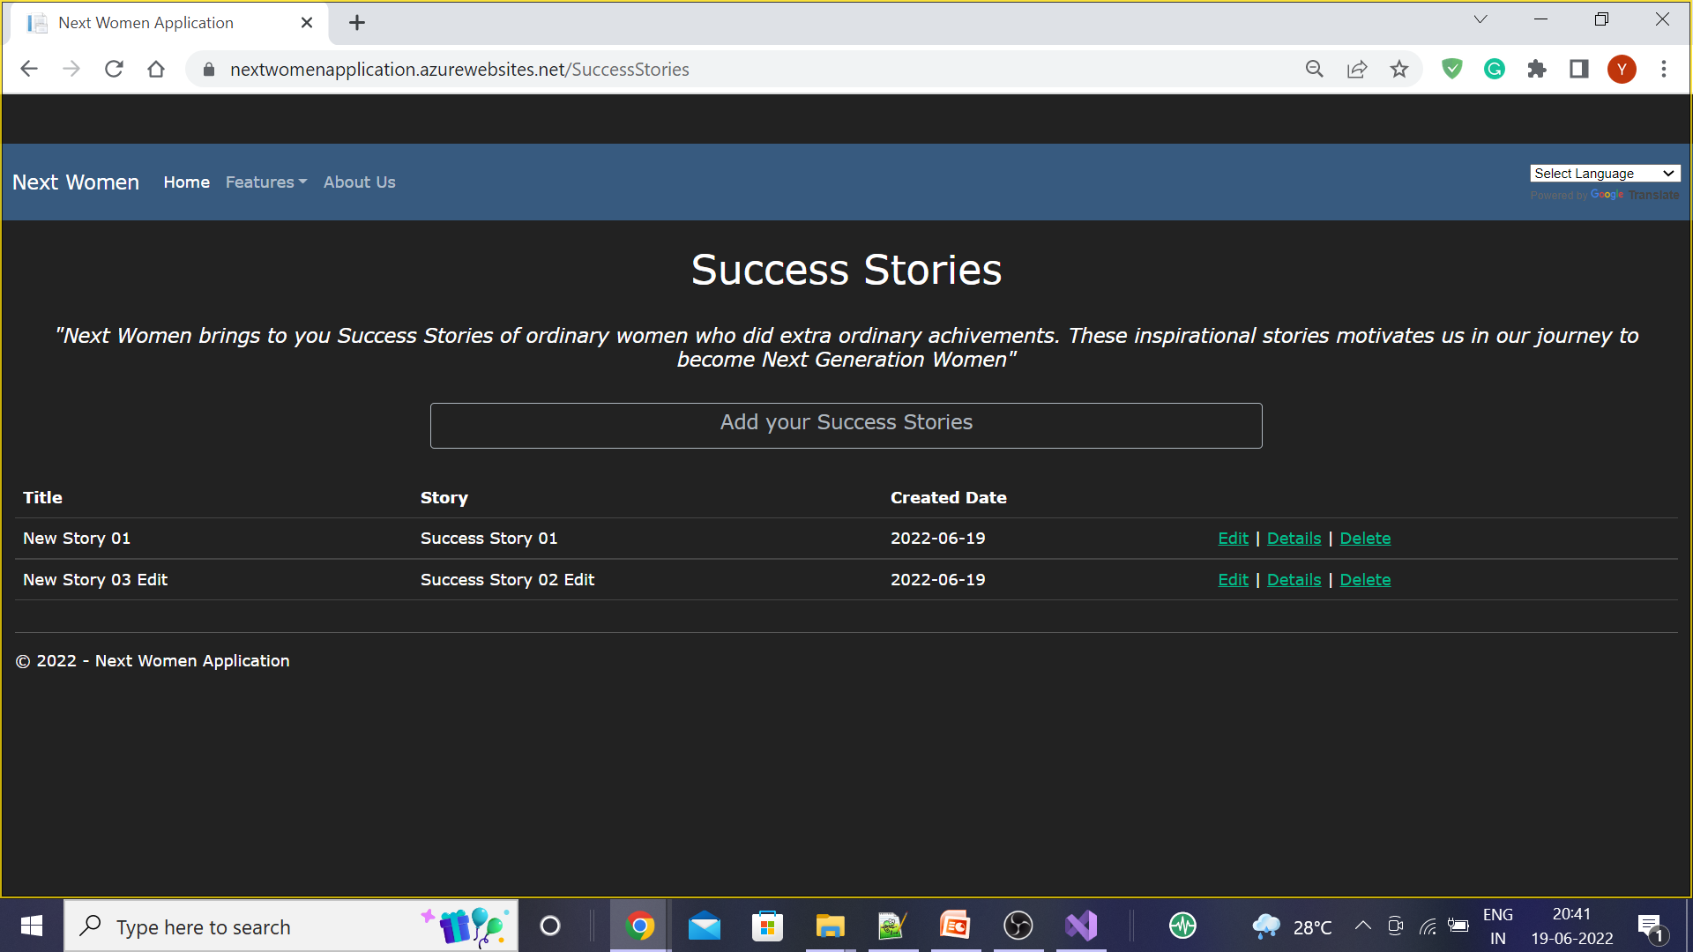
Edit your success story

Slide 13
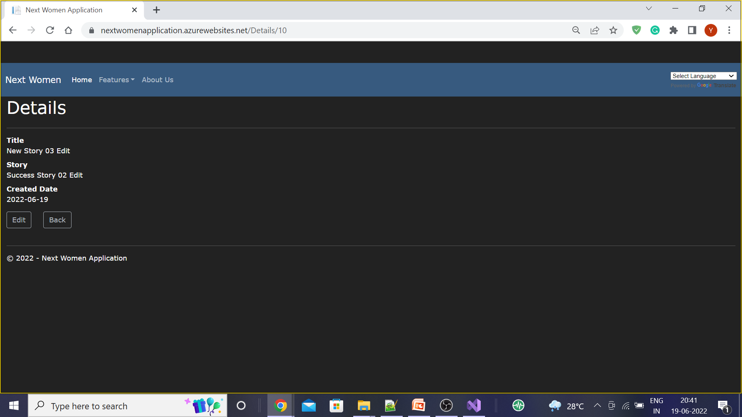
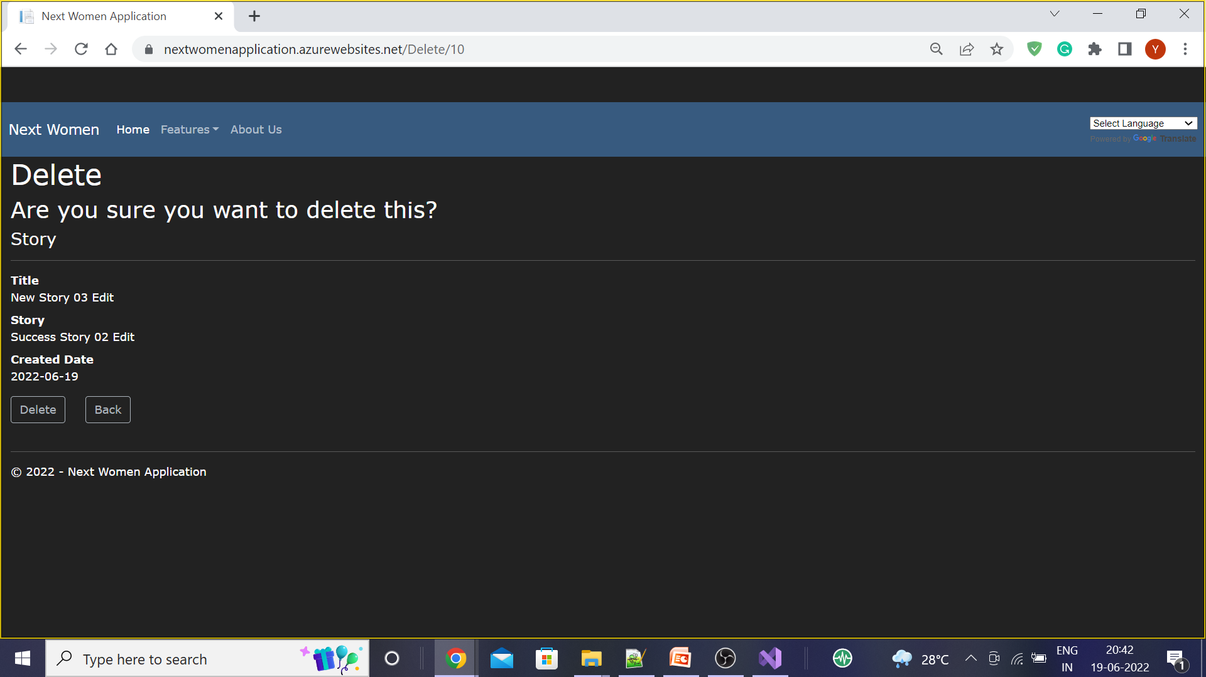
Details and Delete screen

Slide 14
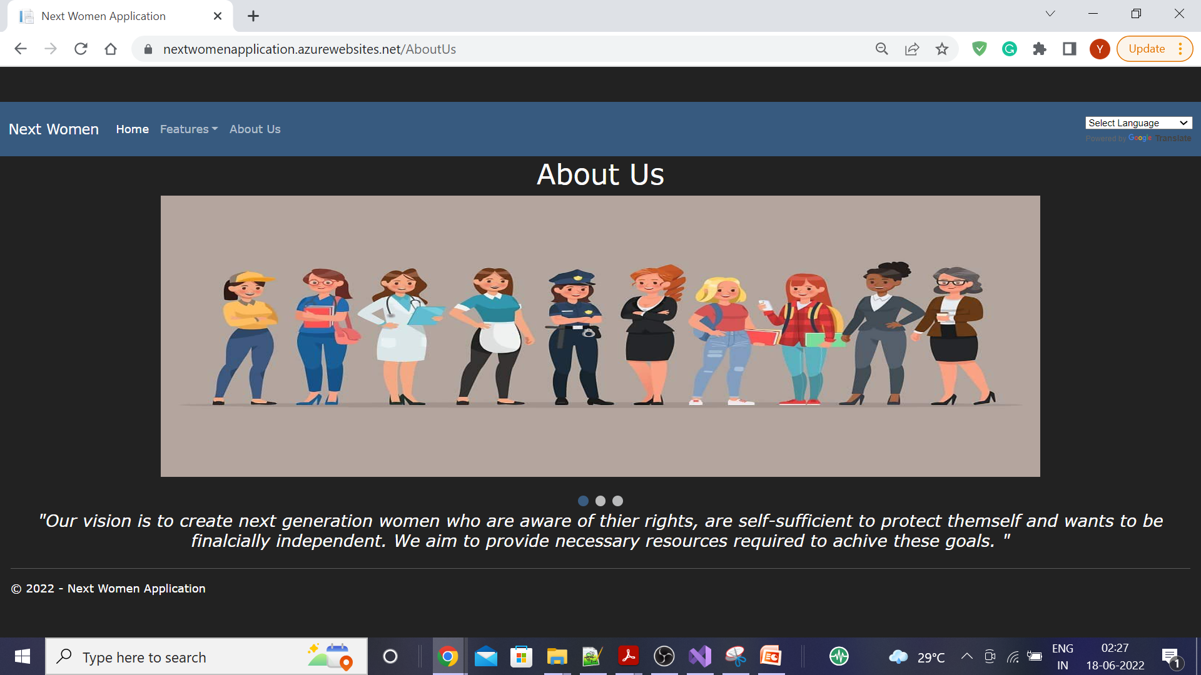
About

Slide 15
Technologies Used
.Net MVC
Azure App Service
Azure SQL Database
HTML,CSS, Javascript, Jquery, Bootstrap
Future Enhancement
Adding Virtual Assistance using cognitive-services-qnamaker
Report Incidents – trigger email to nearest police station.
Group Counselling's
Providing Award to the best success stories.

Slide 16
Thank You!

